Slide 1
Semester: UG 1st CORE Paper- I : Understanding Political Theory UNIT-I Topic Name: What Is Political? Theorizing Political
Presented by
Prof. Gyanaranjan Swain

Slide 2
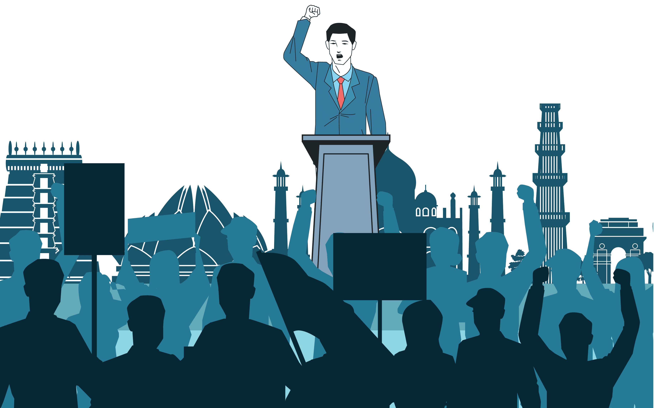
What is political?

Slide 3
What is political?
The term ‘political’ has multiple meanings.
The ﬁrst goes back to classical Greece and is derived from the word ‘polis’ which literally means the city, but is better, more properly understood as a place with a common world or even more simply, a community.
Political’, then, pertains to whatever is done within or by the community.
To be political, to live in the polis, as Hannah Arendt tells us, means that everything is to be decided through words and persuasion and not through force and violence.

Slide 4
Political theory is about how and with what justify decisions are made concerning the good life in a community.
term ‘political’ then may also refer to this collective power.
Thus, we may ask, given that we live by a certain conception of the good life, who is to be a member of the community and why, who is to rule, i.e. take fundamental decisions about the community and for what reasons, how resources are to be distributed, to whom and why.

Slide 5
Meaning: traditional ‘Political’
Meaning: modern ‘political’
Greek societies, decisions were not made by everybody. Power was not exercised by everyone. Slaves, women and aliens were excluded from the decision-making process.
Some people had the power to make decisions about everyone only on condition that they also exercised power over some others.
In modern, the capacity of some people to act in a manner that thwarts the signiﬁcant interest of others, that marginalizes and excludes them, so that they are left with no ability or capacity to take decisions about themselves or about the whole community

Slide 6
Stance on different school:
Political science and theory
Sociology and social theory
This, studied the institutions of the state—the government, the judiciary, the bureaucracy, the military, the police and so on .
It as the study of how these institutions take major decisions on behalf of a small elite or the dominant class to the exclusion of the interests of the subordinate classes or subaltern people
This, on the other hand, studied all those structures, processes and institutions that fell outside the state .
Some people continued to believe that a study of the state was the study of how power was exercised on behalf of and in the interest of all the individuals who make up a particular society

Slide 7
To summarize, the term ‘political’ has multiple meanings:
(a) The collective power to take decisions about every aspect of the good life in the community. Notice that ‘political’ here refers both to power and to ethical values.
(b) The power of some groups to control or subordinate others in order to realize not the good of the entire community but their own narrow interests. In short, to get others to do things that might go against their own interest. Here, the term ‘political’ is used to relate power and self-interest. It also refers to power embodied in a separate institutional apparatus, i.e. the state and, therefore,

Slide 8
(c) to state power used to realize the common good/values, or
(d) state power used to exercise domination by one group over others.
(e) refers to values common to the entire humanity, even all living species. Recall that the political sphere may also include the art of imagining new values and devising new worlds

Slide 9
MCQ
The term ‘political’ derived from;-
a. Latin word
b. Greek word
c. French word
d. English word
2. classical meaning of power as the;’
a. Individual power and interest
b. collective power of the community
c. economic interest of individual
d. NOTA
3. Who stated that, 'Power is acting in concert with each other’?
a. Robert Dahl
b. Max Weber
c. Hannah Arendt
d. Steven Lukes

Slide 10
4. The term ‘Political’ includes;
1. Collective Power
2. Good Life
3. Ethical values
4. Ones own Will
Choose the Correct answer;-
a. 1,3,4 b. 1,2,4 c. 2,3,4 d. 1,2,3,4
5. In ancient Greek societies, decisions were made except;
1. women
2. Slaves
3. Aliens
4. adult male
Choose the Correct answer;-
a. 1,2 only b. 2 only c. 1,2,3 only d. 1,4 only

Slide 11
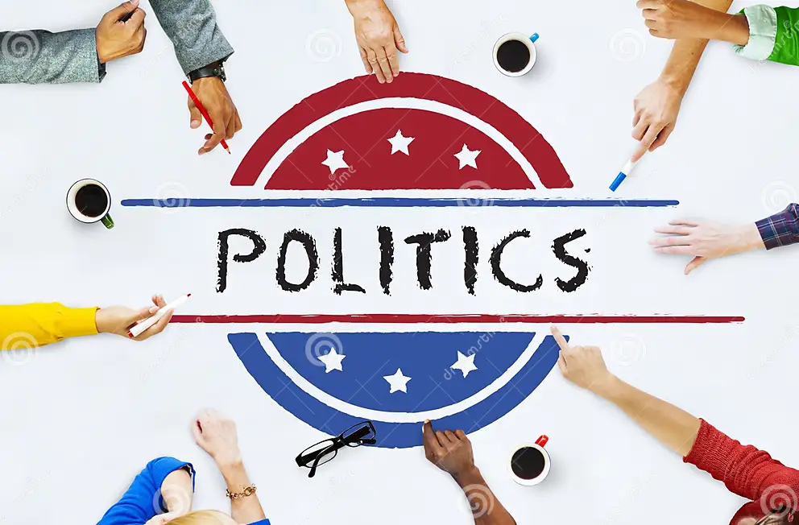

Slide 12
What is politics?
Politics is the set of activities that are associated with making decisions in groups, or other forms of power relations among individuals, such as the distribution of resources or status. The branch of social science that studies politics and government is referred to as political science.
Politics is about making agreements between people so that they can live together in groups such as tribes, cities, or countries. In large groups, such as countries, some people may spend a lot of their time making such agreements.

Slide 13
a process of determining how power and resources are distributed in a society without violence.
the ability to get others to do what you want, Politics arranges our lives into some kind of social order.
Politics, in broadest sense, is the activity through which people make, preserve and amend the general rules under which they live.
Politics as an academic discipline means that embraces a range of theoretical approaches and a variety of schools of analysis.

Slide 14
Notions of politics:
Traditional:
It is also known as speculative, metaphysical and value laden theory. It takes the study of politics very close to the world of the idealist school from. Plato to Bosamquef fall in this category. It is generally criticized for being a deductive, ethics and philosophy. Much of the writings speculative, hypothetical, abstract, imaginative and utopian.
Modern:
Main features of modern politics are the emphasis on empiricism, dissatisfaction with the utopias, search for making politics a science, alternative vision of society on casual lines and a critical. Empiricism, Falsification, Behaviouralism, Hermeneutics, Positivism are modern approach.

Slide 15
Characteristics of politics
Involves conflict or dispute
Requires authoritative decisions
Instrument of conflict-resolution
Involves interest group
Concerned Public goals and decision

Slide 16
Defining politics:
Politics is thus inextricably linked to phenomena of (1) conflict, (2) cooperation.
Conflict
Competition between opposing forces, reflecting a diversity of opinions, preferences, needs or interests.
cooperation
Working together; achieving goals through collective action.

Slide 17
Politics as the art of government:
The word ‘politics’ derived from polis,
Polis: (Greek) city-state; classically understood to imply the highest or most desirable form of social organization.
David Easton; the study of politics is, in essence, to study government, or, more broadly, to the study of authority.
Bismarck; pointed out that ‘ the study of politics is an art of government, the exercise of control within society through the making and enforcement of collective decision.

Slide 18
Politics as public affairs;
In politics, Aristotle man is by nature a political animal; by which he meant that it is only within a political community that human beings can live a ‘good life’. So he called it is the ‘master science’.
1^{st: public}
The state: apparatus of government
2nd :Private
Civil society: autonomous bodies- business, trade unions, clubs, families , and so on.
Public realm: politics, commerce, work, art, culture and so on.
Politics endorse two viewpoints;

Slide 19
Politics as power;
Steven Lukes, in his book Power: A Radical View, conceptualize three faces of political power.
1st
Decision- making:
The process by which an actor such as an individual or political organization evaluates their circumstances and decides on a course of action.
2nd
Agenda setting:
Controlling the terms of dialogue is the second face of power, for ex; the conversation of participants are unable to address issues that are within their benefit.
3rd
Thought control:
This power expressed as ideological indoctrination or psychological control (lukes called this ; Radical power’).

Slide 20
Alan Ball, in his modern politics and government (1988) has indicated two problems arising from the general impression about political activity.
1st
Politics is only concerned with public sector, with parliaments, elections, cabinets, and has little relevance to other sphere of human activity.
2nd
Confusing politics ( party politics, political opinion, party politician seeking power).

Slide 21
Easton's view of politics as
‘Authoritative Allocation of Values’
Values
=
Things considered valuable, whether spiritual or material.
Allocation
=
Distribution of these things to various individuals or group.
Authoritative
=
A situation when people affected by an order think that it is worth obeying

Slide 22
Easton: Decision refers to the ‘selection among alternatives’; policy implies arriving at a decision as well as its implementation: ‘ a policy is authoritative when the people whom it is intended to apply or who are affected by it consider that they must or ought to obey( not brute force).
Examples: the authority has to be render some populistic policies or resources (values), which distribution should be equal among the individuals or groups (allocation) in a legitimate way.
Such as health, education, job, road construction, infrastructure development etc.
Aushman bharat yojana, beti bachao beti padhao, pm kishan yojana, jobs( ssc, banking, upsc, ssb lecture).

Slide 23
Harold Laswell’s book politics: who gets what, when, How? (1936) politics is the study of influence and the influential or the study of shaping and sharing of power.
From this perspective, politics is about diversity and conflict, but the essential ingredient is the existence of scarcity: the simple fact that, while human needs and desires are infinite, the resources available to satisfy them are always limited.

Slide 24
Feminist perspective:
Kate millet in sexual politics (1970), in which she defined politics as ‘power-structured relationships, arrangement's, whereby one group of persons is controlled by others.
Radical feminist hade a slogan ‘ the personal is political’ they have also tended to view politics as a process specifically one related to the exercise of power over others.
Feminist view of politics
Liberal view of politics
Politics as a patriarchal activity
As a means of promoting individuals(male) self-interest
Politics as power domination by the male over female
Power-structured ( group of embers controlled bh another person)
Politics as a state or group activity
As a process of conciliating interest
As a means of promoting common good
Community development structure

Slide 25
Definition:
Hannah Arendt, who argued in The Human Condition (1958) that ‘politics is the most important form of human activity because it involves interaction amongst free and equal citizens.
JS Mill’s view, politics involve in ‘public affairs’ is educational, in that it promotes the personal, moral and intellectual development of the individual.
Bernard Crick in his classic study In defence of politics, politics is the activity by which differing interest within a given unite of rule are conciled by giving them a share in power in portion to their importance to the welfare and survival of the whole community.
Adrain leftwich in his book what is politics? T he activity and its study(2004), ‘politics is at the heart of all collective social activity, formal and informal, public and private, in all human groups, institutions and societies.

Slide 26
For Machiavelli, “politics is an art of coming to power and retaining the power.”
For Henry Adams, “politics is the systematic organization of hatreds.”
For Kl Marks, “politics is merely organized power of one class to oppress another class.
According to Harold Laswell, “politics is the stud of influence and the influential or the study of shaping and sharing of power.
Mahatma Gandhi is often quoted to have said, “politics without ethics is a sin.
Hannah Arendt, “politics is acting in concert.”

Slide 27
MCQ
‘Hermeneutic’ Means:
a. skeptical analysis
b. interpretation
c. behavioral study
d. NOTA
Which book title is wrongly written?
a. Politics; who get what, when, why.
b. Sexual politics
c. The human condition
d. NOTA

Slide 28
‘ The personal is political’ was a slogan of ;
a. Liberal feminism
b. Social feminism
c. Radical feminism
d. communitarianism
4. Which is the best appropriate combination to ‘Define politics’?
a. Dispute and disorder
b. self-interest
c. conflict and cooperation
d. mechanics and methods
According to Steven Lukes, which faces of political power is called as Radical Power’?
a. Agenda setting
b. decision-making
c. NOTA
d. self-control

Slide 29
6. Authority is best described as;
a. power+ agenda
b. propaganda+ power
c. power+ legitimacy
d. power+ order
7. “Politics is the stud of influence and the influential” is a quote by whom?
a. Karl Marx
b. Kate Millet
c. Hannah Arendt
d. Harold Laswell
8. Easton's views of politics as ‘Authoritative Allocation of Values’ in here ‘Values’ represents;
a. Resources
b. Distribution
c. Allocation
d. Groups

Slide 30
9. Bismarck pointed out that ‘ the study of politics is an;
a. Art of public affairs
b. Art of government
c. Art of power
d. Art of man-power
10. Who ‘Defined Politics as power-structured relationship’?
a. Henry Adams
b. M. Gandhi
c. Kate Millet
d. Allan Ball

Slide 31
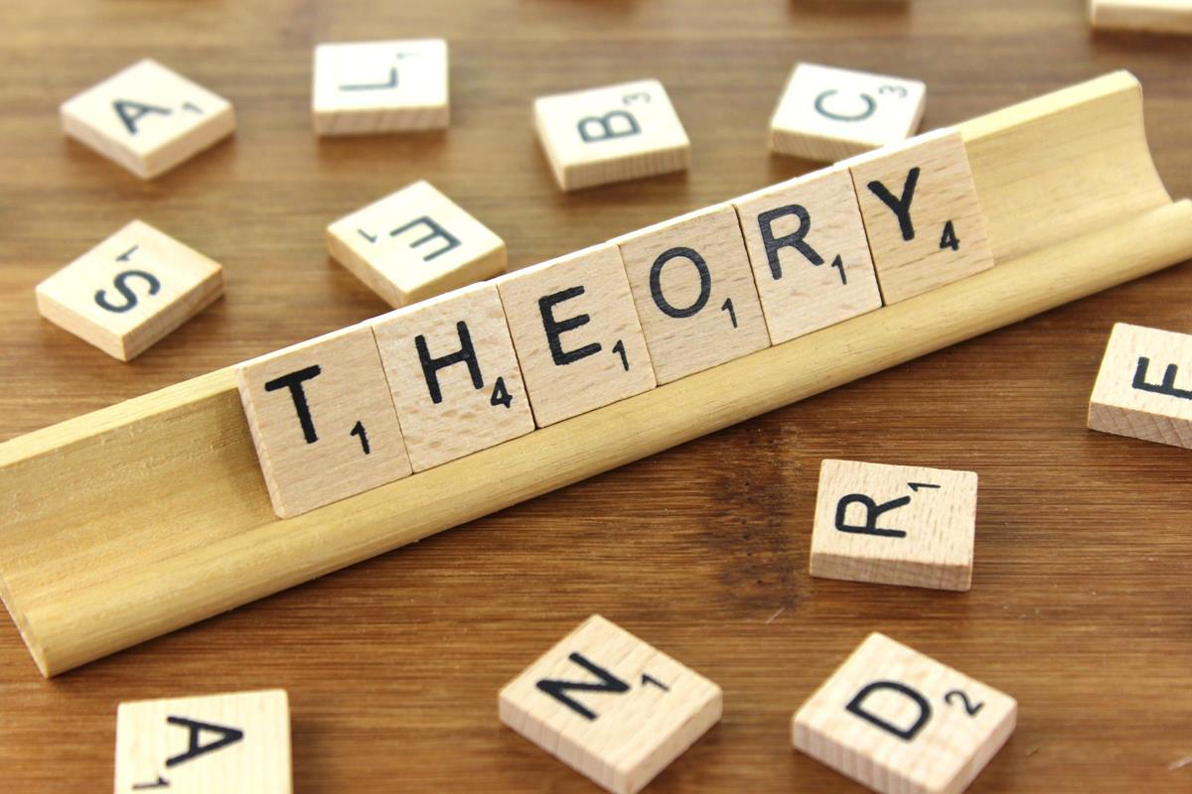
What is political Theory?

Slide 32
What is political theory?
Political theory urges to understand, explain and analyze the political phenomena and suggesting ways and means to rectify the shortcomings.
The objective of political theory is to generalize about the good conduct in the political life and about the legitimate use of power.
Catriona McKinney believes that ‘ political theory is the study of understand the questions like , How we should live together in society.
George Catlin (political quarterly-1957) observed that: ‘ the theory ( of politics) itself is divided into political science and political philosophy’.

Slide 34
It derived from Greek word ‘polis’ means city state.
It refers to decision making within and about the community.
Meaning; Political
1st
The term ‘political’ can be understood through the following points:
a. The collective power to take decision about every aspect of good life of the community.
2nd
b. The power of some groups to control and subordinate others.
c. The state power to realize the common good or values.
3rd

Slide 35
Meaning; Theory
The word ‘theory’ has been derived from the Greek word ‘theoria’ means ‘speculation’.
It means a well focused outlook taken at something in a settle of contemplation with the intent to grasp it.
It is generally considered as a separate branch of political science which attempts to arrive at generalizations and draws inferences or conclusions from the data gathered by various specialists relating to political phenomena.

Slide 37
Definition:
Sabine
Political theory "As anything about politics or relevant to politics.( Broder definition). Political theory is “the disciplined investigation of political problems”. (Narrow definition)
David Held
He defined that “political theories are complex network of concepts and generalizations about political life involving ideas, assumptions on statements about the nature, purpose and key features of governments, state and society, and about the political capabilities of human beings”.
Andrew Hacker
“It is a combination of a disinterested search for the principles of good state and good society on the one hand, and a disinterested search for knowledge of political and social reality.”

Slide 38
scope of Political theory
It deals with the ideas and principles that form the basis for Constitutions, governments, and social life in an organized manner.
It elucidates the meaning of concepts such as freedom, equality, justice, democracy etc.
It probes the meaning of principles such as rule of law, separation of powers, judicial review, etc. by investigating the arguments advanced by different thinkers in defence of these concepts

Slide 39
Though Rousseau, Marx and Gandhi did not become politicians, their ideas influenced generations of politicians worldwide.
Political theorists also reflect upon our current political practices and argue trends and possibilities for the future.

Slide 40
Thank you

